Slide 1
A User-Guided Approach to Program Analysis
Ravi Mangal, Xin Zhang, Mayur Naik
Georgia Tech
Aditya Nori
Microsoft Research
Notes:
11:08

Slide 2


Motivation
Program
Analysis
Program
Analysis
Approximations
Computing exact solutions impossible
Imprecisely defined properties
Analysis Writer
Missing program parts
…
Notes:
Designing program analyses that work in practice remains as much as art as its science
Current approach: Knowledgeable writer designs analyses
Also, needs experience. Uses experience to decide what approximations to incorporate.
Why approximations?
Undecidable problems
Properties ill-defined, For example, consider an analysis trying to find races in the program. Many data races are benign and programmers do want them to be reported. Notion of benign is subjective and not well-defined.
Most large programs call native code i.e code for which we don’t have source code but only the binaries. These are invisible to analysis tools that operate on source/assembly code.
No well defined recipe for choosing approximations. And the guiding principle employed is to choose approximations such that analysis still produces useful results inspite of the inherent imprecision due to the approximations.

Slide 3

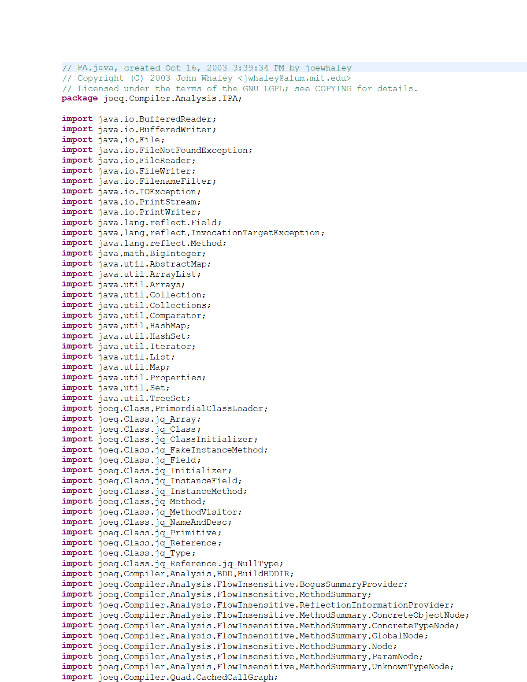
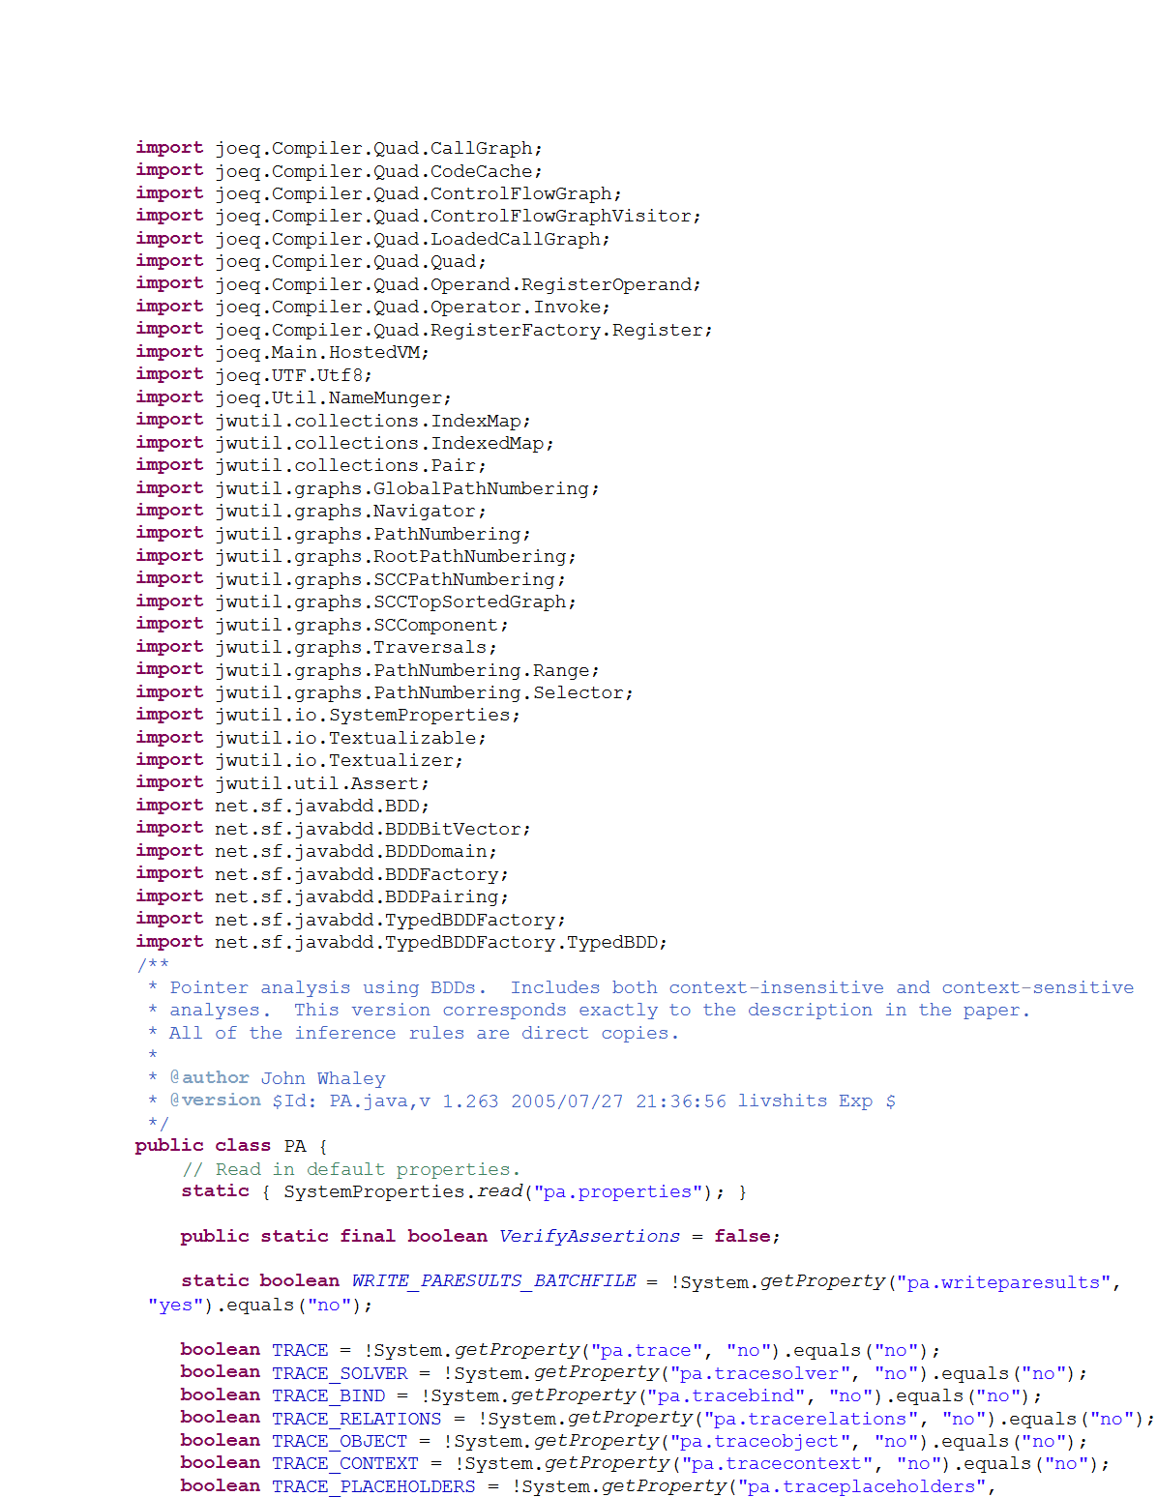


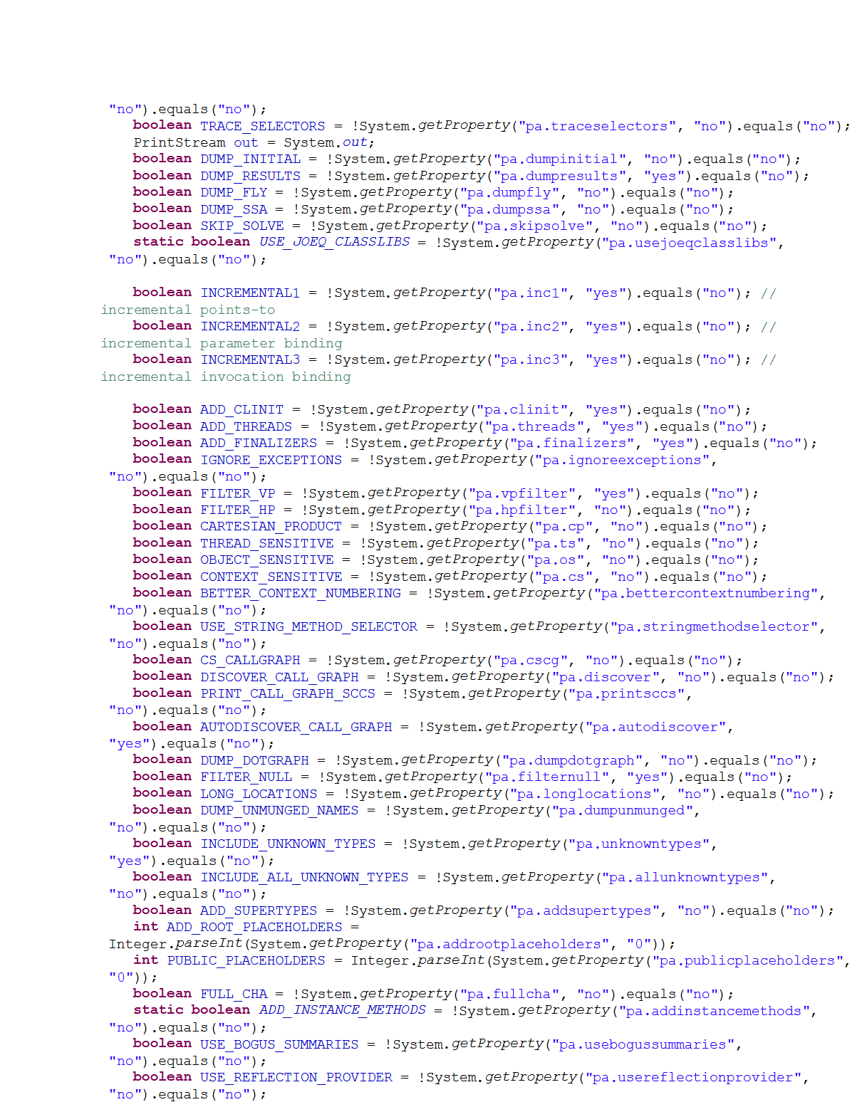
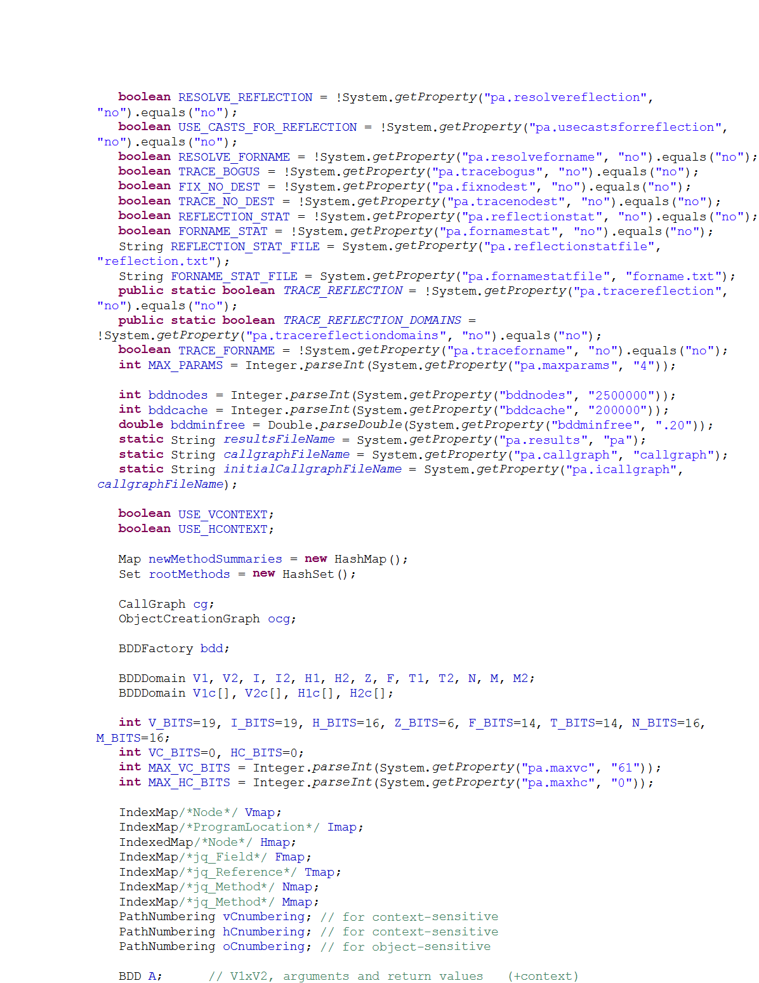
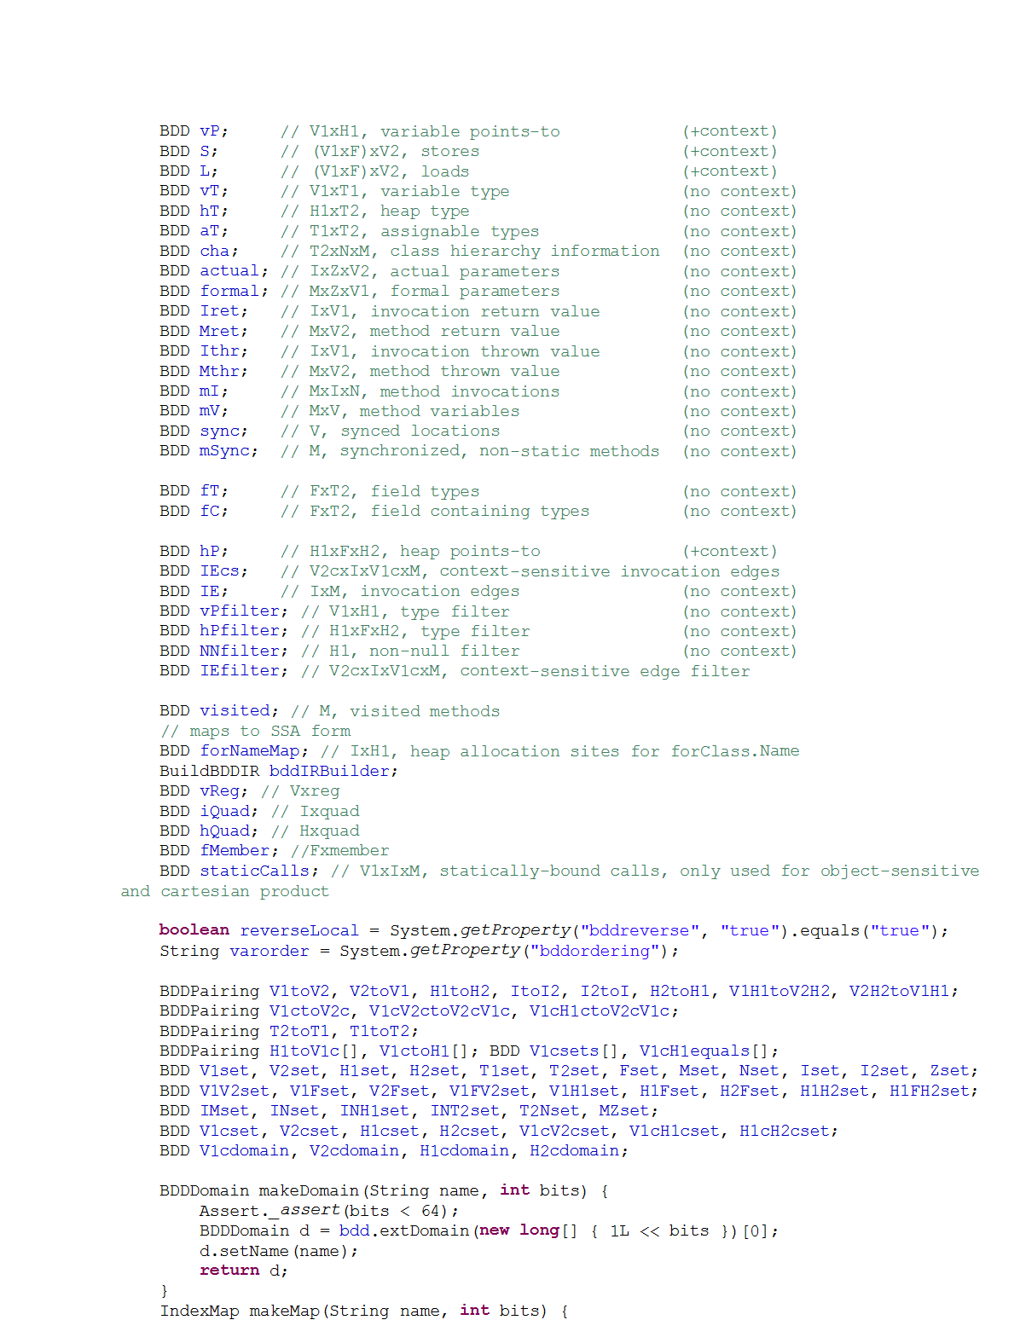
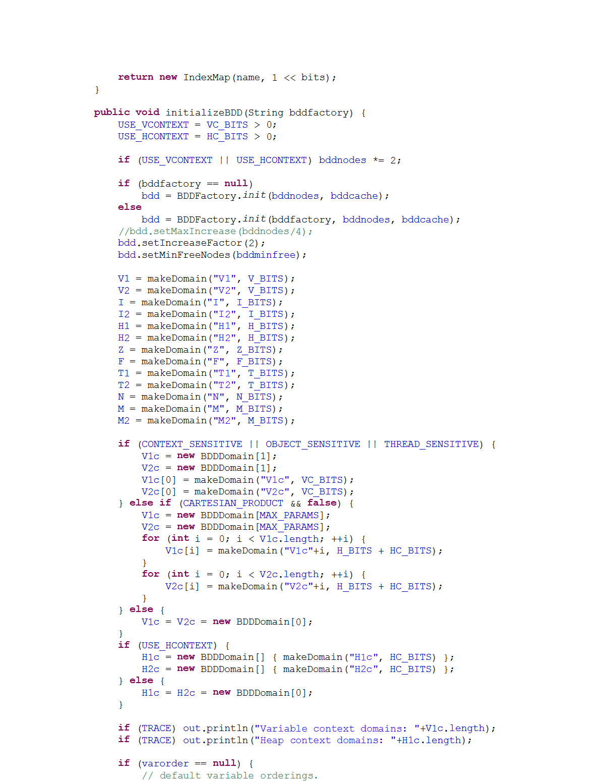
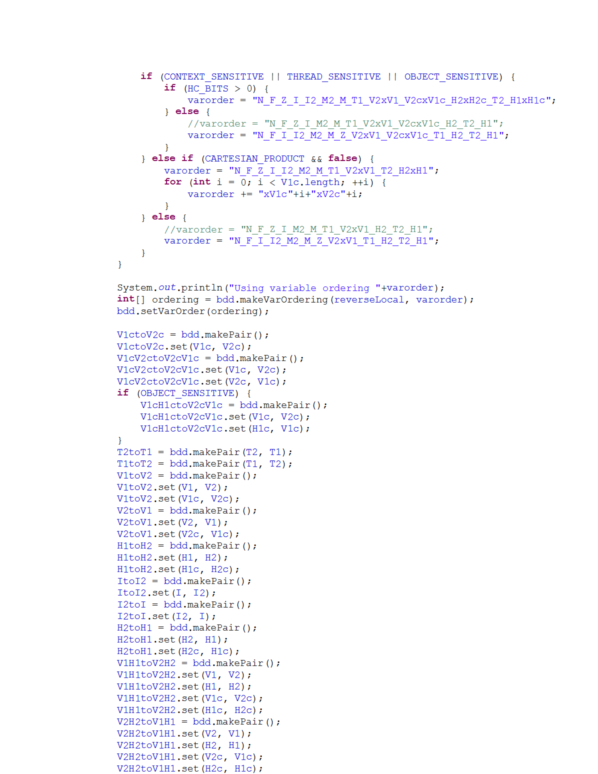
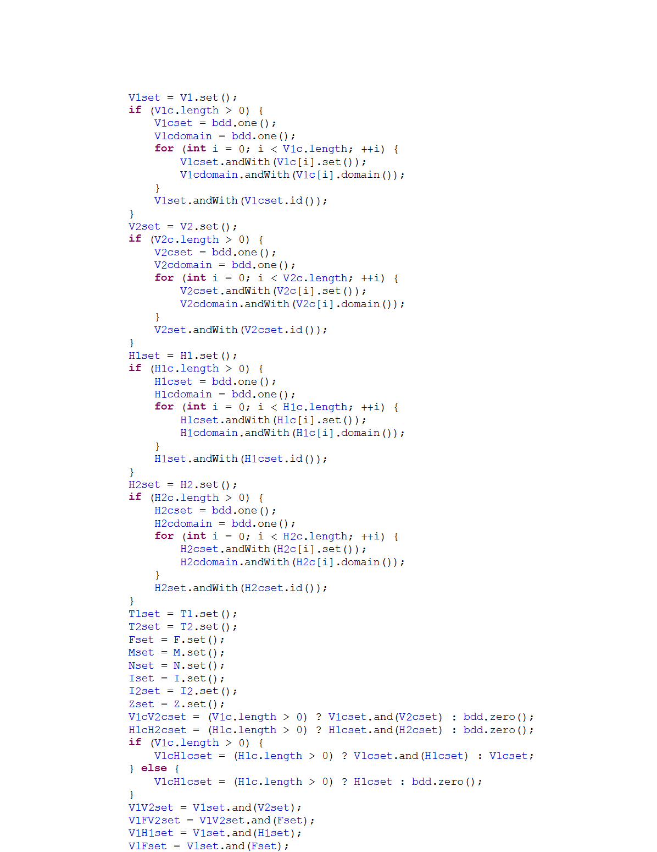
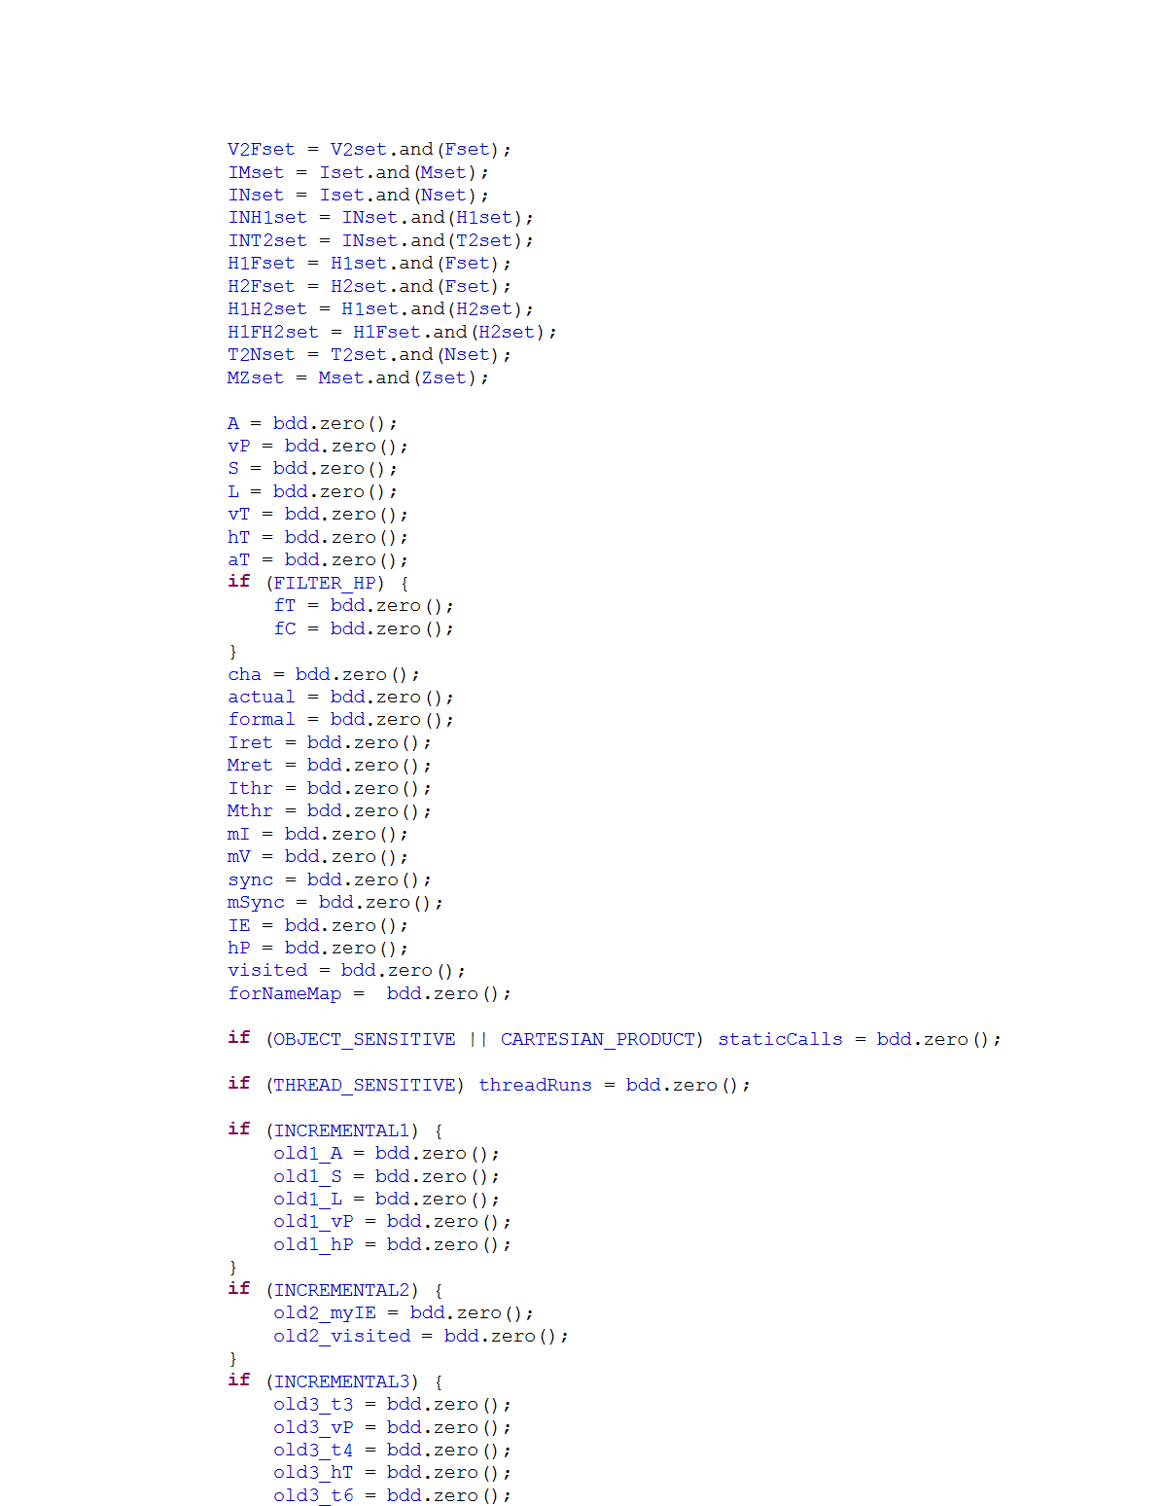
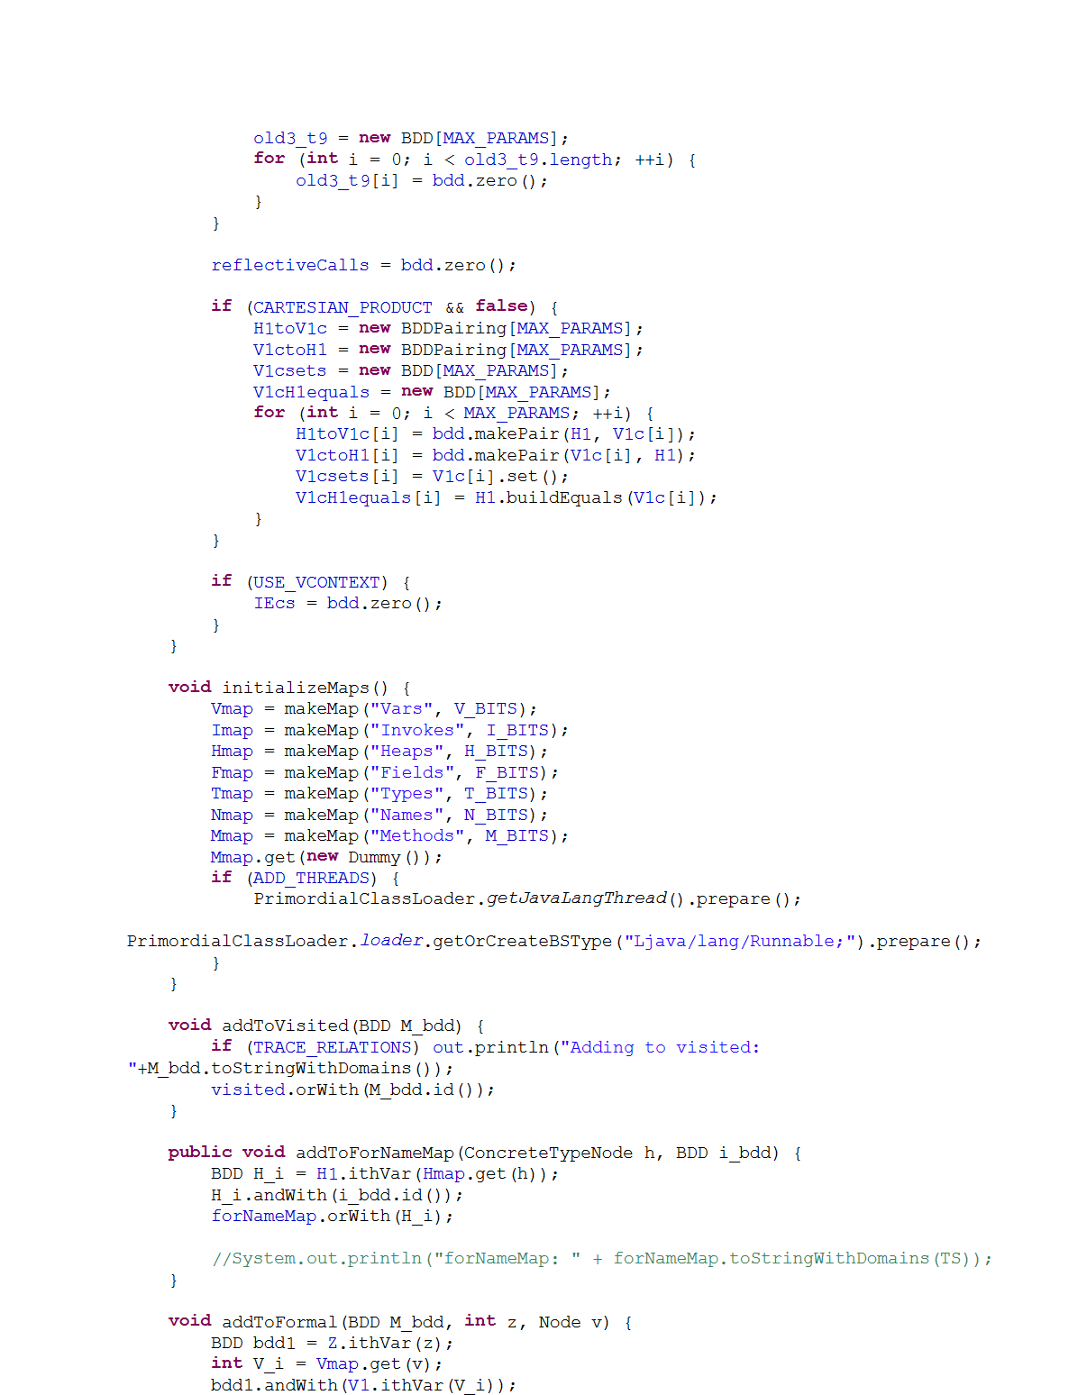
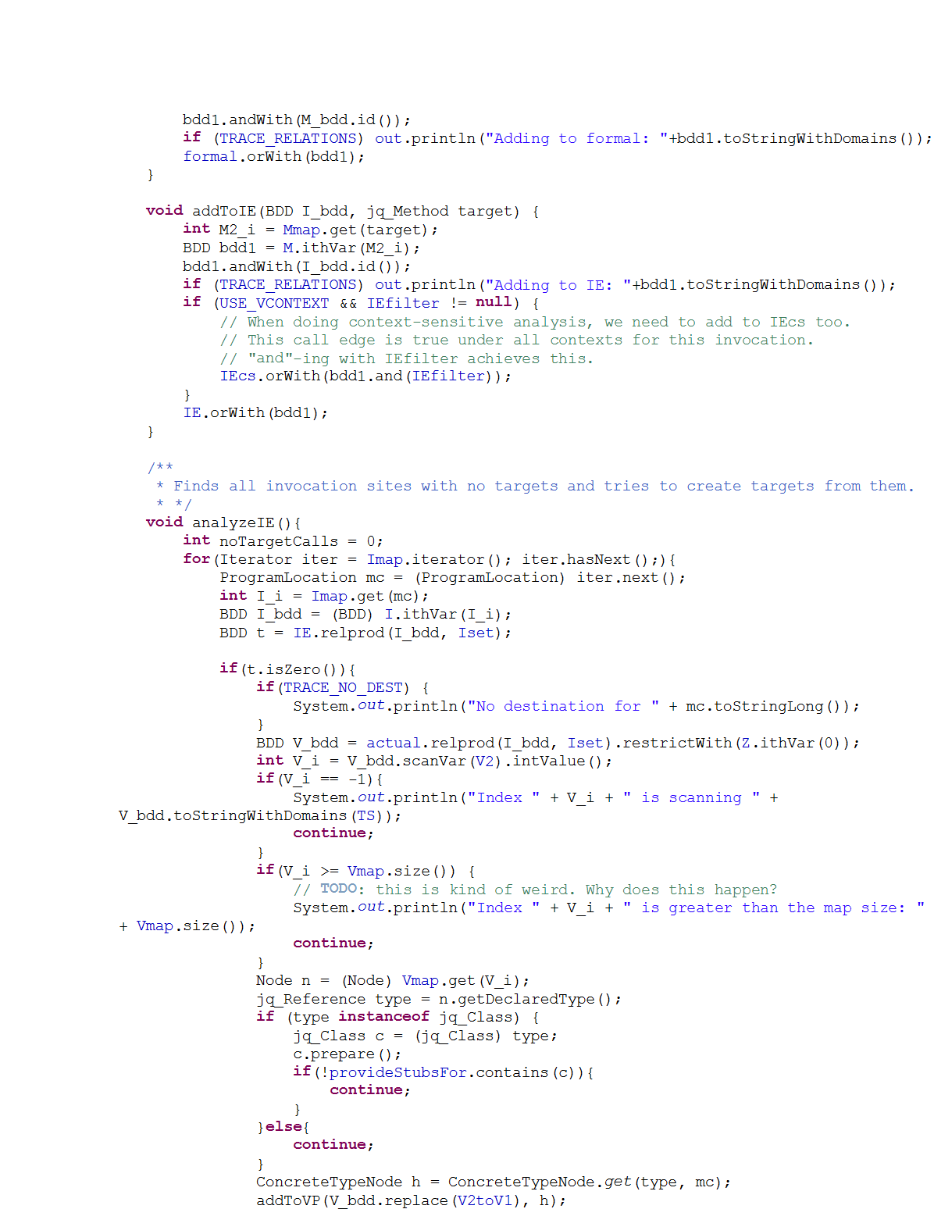
Motivation
Bug Reports
Program
Analysis
Analysis User
“People ignore the tool if more than
30% false positives are reported …”
[Coverity, CACM’10]
Notes:
- On the other side of current picture,
User runs analysis on programs.
For large programs, analysis might produce many reports.
User needs to analyze the reports and fix the bugs.
Problem! Many reports are false alarms.
False alarms because approximations.
Approximations are necessary but guide the approximations.
Much effort wasted leading to user frustration.
Stop using tool.
Key issue: the writer’s notion of usefulness when choosing approximations did not match the user’s notion

Slide 4
Our Key Idea
Shift decisions about usefulness of results
from analysis writers to analysis users
Approximations
Program
Analysis
Feedback
Analysis Writer
Analysis User
Notes:
- Writer still makes decisions about approximations.
User can also give feedback to the analysis tool and guide it towards more acceptable results.
Key technical challenges:
Allow both writer and user to systematically interact with the system
Approach should be smart enough to learn from limited user feedback

Slide 5
Example: Static Datarace Detection
Code snippet from Apache FTP Server
1 public class RequestHandler {
2 FtpRequestImpl request; 3 FtpWriter writer; 4 BufferedReader reader; 5 Socket controlSocket; 6 boolean isConnectionClosed; 7 … 8 public void getRequest( ) {
10 }
11 public void close( ) { 12 synchronized (this) { 13 if (isConnectionClosed)
14 return; 15 isConnectionClosed = true; 16 }
21 reader.close(); 22 reader = null; 23 controlSocket.close(); 24 controlSocket = null; 25 }
17 request.clear(); // x1
R2
18 request = null; // x2
R1
19 writer.close(); // y1
R3
20 writer = null; // y2
9 return request; // x0
R4
R5
Notes:
Example to demonstrate how our tool improves results with user feedback.
Snippet from concurrent program
RequestHandler object handles incoming client requests.
New RequestHandler object created for every new request.
Lot of state stored in each object and multiple threads can access and manipulate an object leading to potential dataraces.
Close() method responsible for clearing state before closing a request connection.
Multiple threads might try to close the connection on the same object.
To ensure no dataraces in close(), isConnectionClosed flag is defined.
Only if not set, state is cleared.
1st thread to call close() sets it, and all subsequent threads return from close() without any action.
Basically, one real race.
Many accesses that look like races but are not because of the isConnectionClosed flag.

Slide 6

Before User Feedback
Notes:
When tool is first run, reports the real race + all pairs of accesses in close()
Reason for all spurious reports is the same: The analysis is unable to reason about the effect of the isConnectionClosed flag.
Not a trivial analysis either,

Slide 7
After User Feedback

Slide 8
Our System For User-Guided Analysis
Notes:
What is offline and online?
Just talked about the user interaction in previous slides. Remind.
High level picture, each component in detail later
2 components
Offline component: Learning engine
Takes in analysis written by analysis writer
And training data in form of programs and the actual bugs in those programs
Produces a probabilistic analysis
Online phase: inference engine
Takes in learned probabilistic analysis and new program to analyze
Also takes user feedback in the form of likes and dislikes
Uses these to produce results
Interaction can continue till user satisfied

Slide 9
Logical Analysis
Notes:
What kind of analyses are accepted by our system?
Syntax and semantics of input analyses?

Slide 10
Logical Datarace Analysis Using Datalog
Input relations:
next(p1, p2), mayAlias(p1, p2), guarded(p1, p2)
Output relations:
parallel(p1, p2), race(p1, p2)
Rules:
parallel(p3, p2) :- parallel(p1, p2), next (p3, p1).
(2) parallel(p1, p2) :- parallel(p2, p1).
race(p1, p2) :- parallel(p1, p2), mayAlias(p1, p2), ¬guarded(p1, p2).
If p1 & p2 may happen in parallel,
and p3 is successor of p1,
then p3 & p2 may happen in parallel.
If p1 & p2 may happen in parallel,
and they may access the same memory location, and they are not guarded by the same lock,
then p1 & p2 may have a datarace.
p1 is immediate successor of p2.
p1 & p2 may access the same memory location.
p1 & p2 are guarded by the same lock.
If p2 & p1 may happen in parallel,
then p1 & p2 may happen in parallel.
p1 & p2 may happen in parallel.
p1 & p2 may
have a datarace.
Notes:
Writer expresses in a language called Datalog
Here we have a simplified datarace analysis in Datalog
Logical language somewhat similar to SQL
3 components:
Input relations equivalent to tables in the world of SQL
Output relations: Results computed by the analysis
Rules for computing the output from input relations
Like SQL queries, but key difference is that recursive queries allowed.
Semantics are to keep applying these rules till a least fixpoint is reached and the output relations stop growing
Lets at this particular datalog analysis implementing a simplified datarace analysis

Slide 11
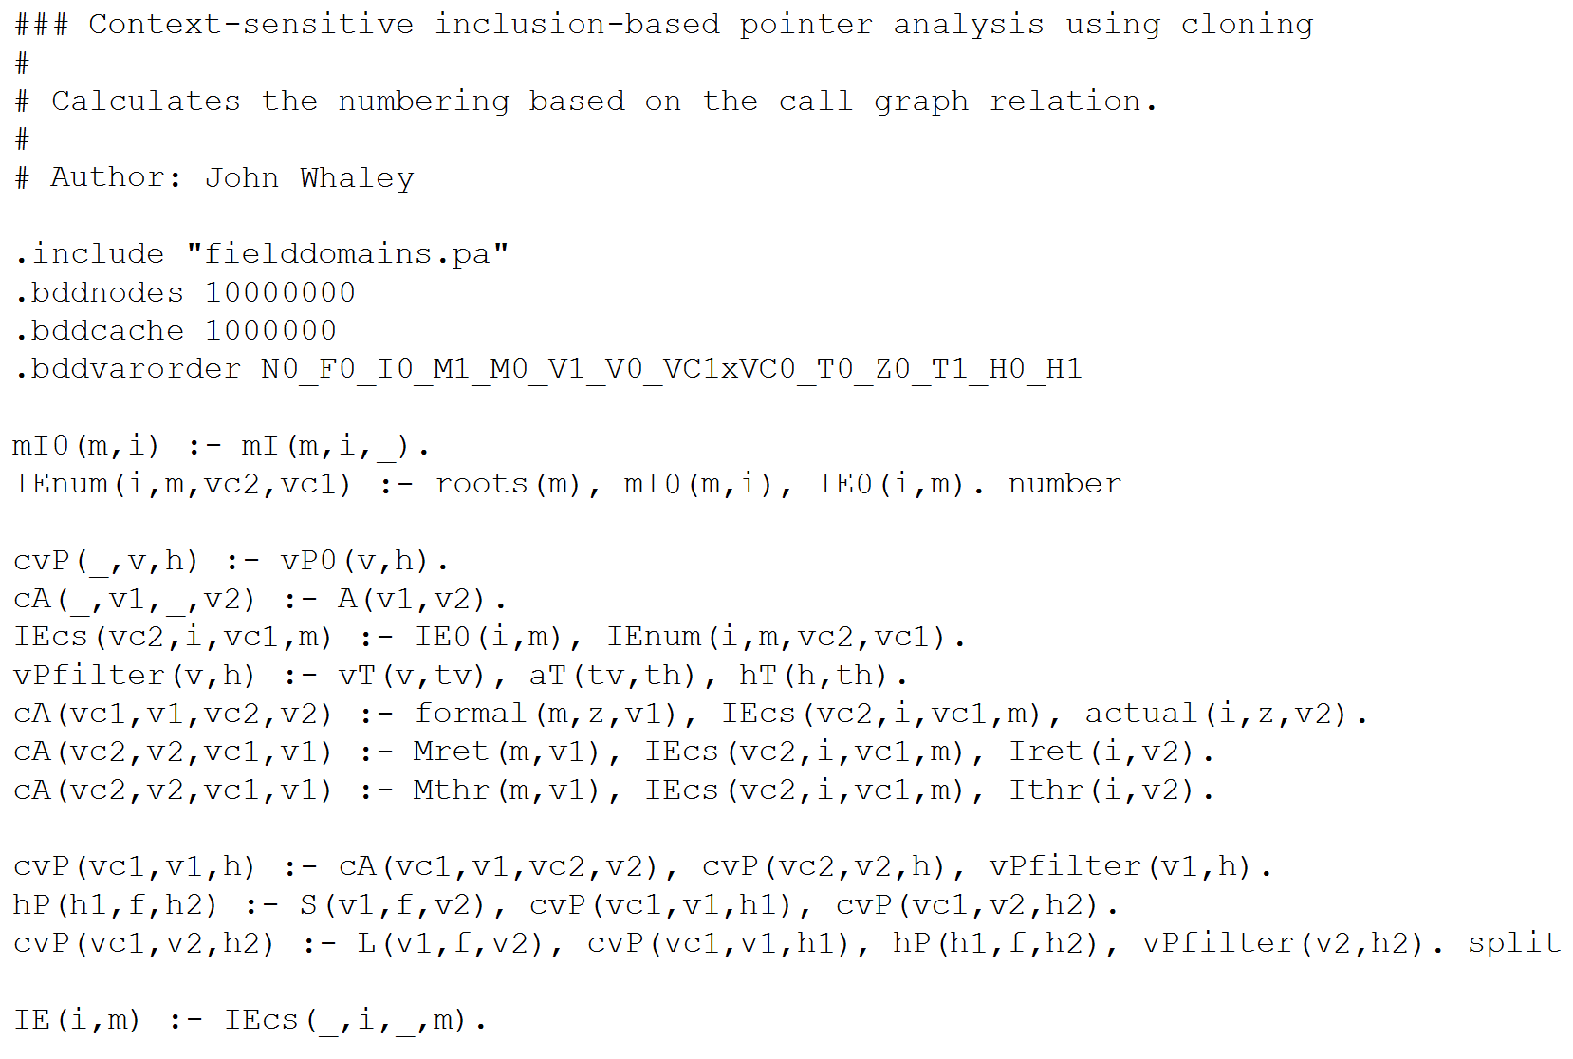
Why Datalog?
Easier to specify
Analysis in Java
Analysis in Datalog
vs.
Notes:
Much easier to specify.
For example, an analysis like datarace analysis can need 1000s of lines of code if written imperatively in Java
Equivalent analysis in datalog is just a few rules
Underlying efficient solvers do the heavy-lifting of solving the constraints
Widely adapted by many program analysis frameworks with many analyses expressed allowing our system to also have a wide adaptability.

Slide 12








Why Datalog?
Easier to specify
Leverage efficient solvers
Widely adaptable
Notes:
Much easier to specify.
For example, an analysis like datarace analysis can need 1000s of lines of code if written imperatively in Java
Equivalent analysis in datalog is just a few rules
Underlying efficient solvers do the heavy-lifting of solving the constraints
Widely adapted by many program analysis frameworks with many analyses expressed allowing our system to also have a wide adaptability.

Slide 13
Probabilistic Analysis
Notes:
We transform datalog to modified form called probabilistic.
Basically, all datalog rules in datalog are hard rules that cannot be ignored or violated while producing the output relations.
In order to incorporate user feedback into the analysis, its necessary to have the capability to violate or ignore some of the approximations added by the writer, for which we need soft rules that can be violated.
Hence, we have probabilistic analysis.
Can view as intermediate language of the tool
Allows to systematically incorporate use feedback and writer approximations

Slide 14
Datarace Analysis: Logical ➔ Probabilistic
Input relations:
next(p1, p2), mayAlias(p1, p2), guarded(p1, p2)
Output relations:
parallel(p1, p2), race(p1, p2)
Rules:
parallel(p3, p2) :- parallel(p1, p2), next (p3, p1).
(2) parallel(p1, p2) :- parallel(p2, p1).
race(p1, p2) :- parallel(p1, p2), mayAlias(p1, p2), ¬guarded(p1, p2).
¬race(x2, x1).
“Soft” Rule
“Hard” Rule
weight 5
weight 25
Notes:
Similar to Datalog but rules have weights now
Rules with weights are soft rules that can be violated
Hard rules without weights cannot be violated.
Intuitively, weights convey confidence in the validity of the rule.
High weight conveys high confidence in a rule and low weight, low confidence.
Typically, a role is made soft if it represents some approx included by the writer.
In this example, in the 1st rule, it seems overly conservative to say that if p1,p2 parallel then successor also parallel.
However, hard rules here fairly accurately capture notion of datarace.
Finally, user feedback also included as a soft rule with relatively high weight
For example,
Basically, we have a bunch of soft rules and hard rules, where soft rules express approximations or feedback.
Typically, all rules cannot be satisfied.
Inuitively, we want analysis to pick output that satisfies most rules or violates least rules.

Slide 15
A Semantics for Probabilistic Analysis
Probabilistic Analysis => Markov Logic Network (MLN)
[Richardson & Domingos, Machine Learning’06 ]
MLN defines a probability distribution over all possible analysis outputs
Probability of an output x:
Normalization
factor
Weight of
rule i
Number of true instances of rule i in x
Notes:
Formally, we noticed that our intuitive semantics of probabilistic analysis are formally captured by prob model called MLN.
MLNs are blah blah.
Our probabilistic analysis can be seen as defining a probability distribution over all possible outputs.
Analysis does not have just a unique output as in the case of Datalog analyses.

Slide 16
Inference Engine
Notes:
- Use same term i.e. rules througout

Slide 17
Probabilistic Inference
Find the most likely output given the input program
Notes:
Argument which maximizes x, also maximizes e^x
Most likely output means output with highest probability.
Find output y such that probability of y given input program x is maximum.
We can only care about the output y and not the actual probability.
Can drop Zx since it’s a constant
Can also reduce the exponential term to just a summation since exponentiation is monotonic function.
Reduced to finding the assignment y such that the sum of the weights of the satisfied rules is maximized.

Slide 18
What is MaxSAT?
¬ b1 ∨ ¬ b2 ∨ b3 weight 5 ∧
b3 ∨ b4 weight 10 ∧
¬ b4 ∨ ¬ b2 weight 7 ∧
...
Find a boolean assignment such that the sum of
the weights of the satisfied clauses is maximized

Slide 19
Probabilistic Inference ➔ MaxSAT
Find the most likely output given the input program
Solve the MaxSAT instance entailed by the MLN
Notes:
Most likely output means output with highest probability.
Find output y such that probability of y given input program x is maximum.
We can only care about the output y and not the actual probability.
Can drop Zx since it’s a constant
Can also reduce the exponential term to just a summation since exponentiation is monotonic function.
Reduced to finding the assignment y such that the sum of the weights of the satisfied rules is maximized.

Slide 20
Example: Static Datarace Detection
Code snippet from Apache FTP Server
1 public class RequestHandler {
2 FtpRequestImpl request; 3 FtpWriter writer; 4 BufferedReader reader; 5 Socket controlSocket; 6 boolean isConnectionClosed; 7 … 8 public void getRequest( ) {
10 }
11 public void close( ) { 12 synchronized (this) { 13 if (isConnectionClosed)
14 return; 15 isConnectionClosed = true; 16 }
21 reader.close(); 22 reader = null; 23 controlSocket.close(); 24 controlSocket = null; 25 }
17 request.clear(); // x1
R2
18 request = null; // x2
R1
19 writer.close(); // y1
R3
20 writer = null; // y2
9 return request; // x0
R4
R5

Slide 21
How Does Online Phase Work?
Input facts: next(x2, x1), mayAlias(x2, x1), ¬guarded(x2, x1), next(y1, x2), mayAlias(y2, y1), ¬guarded(y2, y1)
MaxSAT formula: (parallel(x1, x1) ∧ next(x2, x1) => parallel(x2, x1)) weight 5 ∧
(parallel(x1, x2) ∧ next(x2, x1) => parallel(x2, x2)) weight 5 ∧
􏰂 (parallel(x2, x2) ∧ next(y1, x2) => parallel(y1, x2)) weight 5 ∧ (parallel(y2, y1) ∧ mayAlias(y2, y1) ∧ ¬guarded(y2, y1) => race(y2, y1)) ∧
(parallel(x2, x1) ∧ mayAlias(x2, x1) ∧ ¬guarded(x2, x1) => race(x2, x1)) ∧
¬race(x2, x1) weight 25
Output facts (before feedback): parallel(x2, x0), race(x2, x0), parallel(x2, x1), race(x2, x1), parallel(y2, y1), race(y2, y1)
Output facts (after feedback):
parallel(x2, x0), race(x2, x0)

Slide 22
Learning Engine

Slide 23
Weight Learning
Learn rule weights such that the probability
of the training data is maximized
Perform gradient descent
[Singla & Domingos, AAAI’05]

Slide 24
Putting It All Together

Slide 25
Empirical Evaluation Questions
RQ1: Does user feedback help in improving analysis precision?
RQ2: How much feedback is needed and does the amount of feedback affect the precision?
RQ3: How feasible is it for users to inspect analysis output and provide useful feedback?

Slide 26
Empirical Evaluation Setup
Control Study:
Analyses: (1) Pointer analysis, (2) Datarace analysis
Benchmarks: 7 Java programs (130-200 KLOC each)
Feedback: Automated [Zhang et.al, PLDI’14]
User Study:
Analyses: Information flow analysis
Benchmarks: 3 security micro-benchmarks
Feedback: 9 users
Notes:
- Setting in detail

Slide 27
Benchmarks Characteristics
 | classes | methods | bytecode(KB) | KLOC
antlr | 350 | 2.3K | 186 | 131
avrora | 1,544 | 6.2K | 325 | 193
ftp | 414 | 2.2K | 118 | 130
hedc | 353 | 2.1K | 140 | 153
luindex | 619 | 3.7K | 235 | 190
lusearch | 640 | 3.9K | 250 | 198
weblech | 576 | 3.3K | 208 | 194
secbench1 | 5 | 13 | 0.3 | 0.6
secbench2 | 4 | 12 | 0.2 | 0.6
secbench3 | 17 | 46 | 1.3 | 4.2
Control
Study
User
Study

Slide 28
Precision Results: Pointer Analysis
10%
5%
20%
15%
Notes:
Focus on 1 benchmark to explain graph
Imprecise analysis on avrora produces 119 + 75 i.e. 194 reports
By consulting the precise analysis, we can classify as 119 true and 75 false.
We want to check if by providing feedback we can eliminate the false positives while retaining the true positives.
For this methodology is to randomly pick a subset of reports produced, and correctly label these reports by querying the precise analysis.
A report produced by both gets “like” feedback and report produced by only the imprecise analysis get “dislike” feedback.
Rerun the expt and check percentage of false +ve eliminated and true +ve retained.
Perform 4 expts with different amount of feedback.
In 1st expt, provide feedback on 5% of the produced reports.
Amount of feedback indicated by dark grey section.
Bar above x axis indicates % false positives eliminated; 60% in this case. Ideally want to be 100%
Bar below y axis indicates % true positives retained, 100% in this case which is the ideal case.

Slide 29
Precision Results: Datarace Analysis
RQ1, RQ2: With only up to 20% feedback, 70% of the false positives are eliminated and 98% of true positives retained.

Slide 30
Precision Results: User Study
User 6
…
User 2
User 1
RQ3: Users only need 8 minutes on average to provide
useful feedback that improves analysis precision
showing feasibility of approach.
Notes:
- Usability of the system. Talk about time needed by users to give feedback.

Slide 31
Conclusion
Approximations are a necessary evil in program analysis
Our contributions:
Paradigm: Incorporate user feedback to guide approximations
Method: Datalog ➔ MLN ➔ MaxSAT
Results: Eliminates most false positives (~70%) at the cost of introducing few false negatives (~2%) with limited feedback
Systematically combining program analysis and machine learning techniques with human intelligence is the future

Slide 32
Feasibility Results: User Study
RQ3: Users only need 8 minutes on average to provide feedback showing feasibility of approach.
Notes:
- Usability of the system. Talk about time needed by users to give feedback.

